Slide 1
Golden Rules of Accounting and Journal
Accounting Rules

Slide 2
Type of Accounts
1. Real Accounts
2. Personal Accounts
3. Nominal Accounts

Slide 3


Real Account
Real accounts record the assets
Asset is that valuable thing or property which the business owns and get the benefits from it in future or use it in generating income.
Cash
Motor Van
Building
Machinery
Furniture

Slide 4


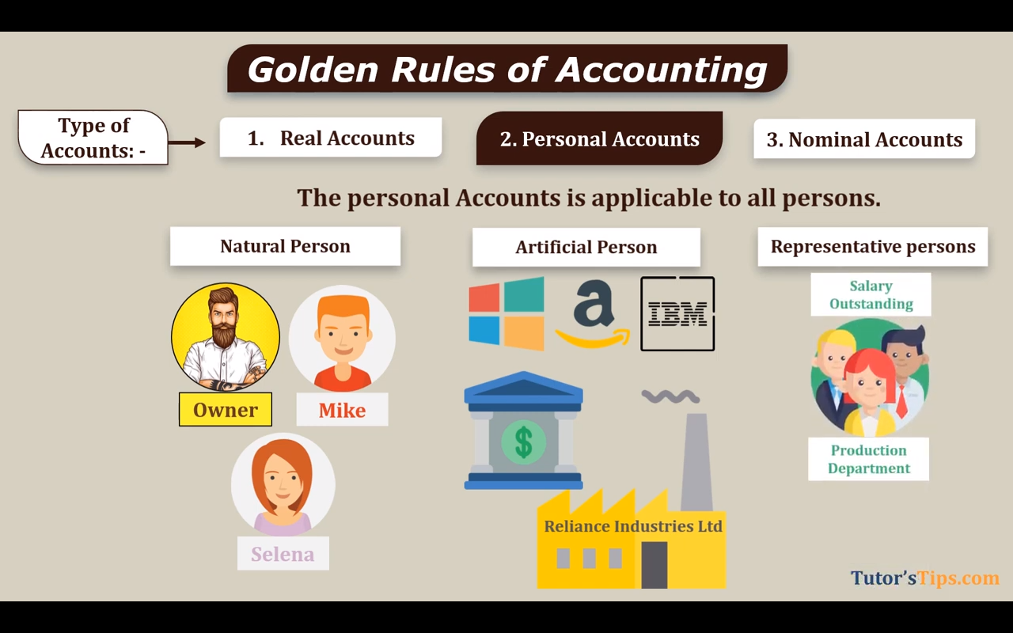




Personal Account
These of Accounts are related to Persons. These persons may be natural persons like Raj's account, Rajesh's account, Ramesh's account, Suresh's account, etc. These persons can also be artificial persons like partnership firms, companies, bodies corporate, an association of persons, etc. Person can also be Representative like Outstanding Salary, Prepaid Rent.
Types of Personal Account
Natural Person
Artificial Person
Representative Person
Rajesh A/c
Sujata A/c

Slide 5
Nominal Account
As per the golden rules of accounting, Nominal accounts include those accounts that are related to all expenses/losses and incomes/gains like Salary, Wages, Purchases, Electricity bill, Sales, Commission Received, Transportation charges, Rent Etc.
Expenses
Incomes
Losses
Gains/Profit
Salary, Wages,
Purchases,
Electricity bill,
Advertisement
Transportation charges,
Rent Paid, Etc.
Sales,
Commission Received,
Rent received,
Discount Received
Interest Received Etc.
Loss on sale
of an asset,
Loss by Theft,
Loss by fire,
loss by an
accident, Etc.
Profit on sale of
an asset, Etc.

Slide 6
Real Accounts | Personal Accounts | Nominal Accounts
Cash | Raj's Account | Salary Expense
Land | Priya's Account | Rent Expense
Furniture | HDFC Bank | Commission Received
Building | XYZ Ltd. | Interest Received
Machinery | Creditors | Discount Allowed
Computers | Debtors | Discount Received
Stock (Inventory) | Capital Account | Electricity Expense
Patent | Suppliers | Insurance Expense
Goodwill | Customers | Sales Revenue
Vehicle | State Bank of India | Wages Expense

Slide 7
Investments Account | Partner's Capital Account | Carriage Inward Account
Stock (Inventory) Account | Partner's Current Account | Carriage Outward Account
Leasehold Property Account | Outstanding Salary Account | Freight Charges Account
Freehold Property Account | Outstanding Rent Account | Depreciation Account
Warehouse Account | Loan from Bank Account | Sales Account
Bills Receivable Account | Loan from Ram Account | Purchase Account
Bills Payable Account | Shareholder's Account | Profit on Sale of Asset Account
Fixtures Account | Government Account | Loss on Sale of Asset Account
Work-in-Progress Account | Accrued Income Account | Royalty Paid Account
Finished Goods Account | Unearned Income Account | Royalty Received Account
Raw Materials Account |  | Bad Debts Account

Slide 8
Identify whether each account is Real, Personal, or Nominal.
1 Cash _________
2 Purchases _________
3 Rent Expense _________
4 Machinery _________
5 Rahul's Account _________
6 Sales _________
7 Furniture _________
8 Wages _________
9 State Bank Account _________
10 Goodwill _________
11 Commission Received _________
12 Building _________
13 Creditors _________
14 Electricity Expense _________
15 Patent _________
16 Debtors _________

Slide 9
17 Insurance Expense _________
18 Land _________
19 Interest Received _________
20 ABC Traders _________
21 Motor Vehicle _________
22 Salaries _________
23 Capital Account _________
24 Stock (Inventory) _________
25 Discount Allowed _________
26 Discount Received _________
27 Computers _________
28 Bank Loan _________
29 Printing Expense _________
30 Purchase Returns

Slide 10
Rules of Account
Types of Account | Debit | Credit
Personal A/c | The Receiver | The Giver
Real A/c | What Comes In | What Goes Out
Nominal | All Expenses and Losses | All Income and Gains

Slide 11
Journal Entry
Journal is a book in which all the transactions of a business are recorded for the first time. Every transaction affects two accounts, one is debited and the other one is credited. ‘Debit’ (Dr.) and ‘Credit’ (Cr,) are the two terms or signs used to denote the financial effect of any transaction. The format of Journal Entry is prepared with 5 columns starting from Date, Particulars, Ledger Folio (LF), Debit Amount & Credit Amount.
The word ‘journal’ has been derived from the French word ‘JOUR’ meaning daily records. Journal Book is maintained to have prime records for small firms. After preparing the journal book, the transactions are then posted to Ledger.
Date | Particulars | L.F | Dr Rs. | Cr. Rs.
Year | Name of A/c Debited………………Dr |  | ------
 | To Name of A/c Credited |  |  | ………
 | (Being………………………)

Slide 12
Ledger
Definition: The ledger, also known as the book of final entry, is a collection of accounts that shows the changes made to each account as a result of financial transactions. Each account has a separate page or section in the ledger.
Purpose:
To categorize and summarize the transactions recorded in the journal.
To provide the balances of each account.
To help prepare financial statements.
Format: A ledger account is often presented in a T-account format:
Date | Particulars | J.F | Amt | Date | Particulars | J.F | Amt
Year Month | To Name of A/c to be Credited |  |  | Year Month | By Name of A/c to be Debited
 |  |  | xxx |  |  |  | xxx
Year | To Balance C/d* |  | xxx | Year | By Balance C/d* |  | xxx
Month |  |  |  | Month

Slide 13
Examples
1.Neerose Commenced his business with capital of Rs.100000
2.Bought Machinery Rs.30000
3.Bought Goods for cash from Ram Rs.5000
4.Credit sales to Harish Rs.3400
5.Bought Goods from Komal on Credit Rs. 1920
6.Paid Insurance Premium Rs.3000
7.Paid Salary to Clerk Rs.3500
8.Cash Withdrawn By proprietor for personal use Rs.5000

Slide 14
Trial Balance
Definition: A trial balance is a statement that lists all the ledger accounts with their respective debit or credit balances on a specific date. The total of debit balances should equal the total of credit balances.
Purpose:
To verify the mathematical accuracy of the ledger.
To ensure that debits equal credits after posting transactions.
To assist in preparing financial statements.
Format: A trial balance typically includes:
Debit balances ; Assets and Expense
Credit balances : Liabilities , Capital and Income

Slide 15
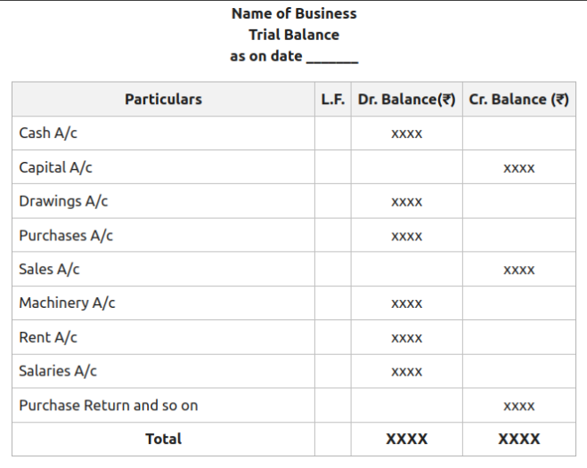

Slide 16
Examples
Purchases 60000
Reserve Fund 20000
Sales 100000
Purchase Return 1000
Sales Return 2000
Opening Stock 30000
Expenses 20000
Outstanding Exp. 2000
bank Bal.5000
Fixed Assets 50000

Slide 17
Difference Between Journal and Ledger
Basis | Journal | Ledger
Nature of Book | Book of Primary Entry | Book of Secondary Entry
Basis of Preparation | It is Prepared on the basis of Sources of Transaction | It is Prepared on the basis of the entries recorded in the Journal
Stages of Recording | Journal Entries are first stage of recording a transaction | Posting in the ledger is the second stage of recording
Object | with the obejctive of recording all business transaction in cronological order | With the objective of knowing the net impact of various transactions
Balalcing | There is no concept of balalcing a Journal | All the Ledger accounts are required to be balalced
Narration | Writing a narration is must in respect of each entry | No narration required

Slide 18
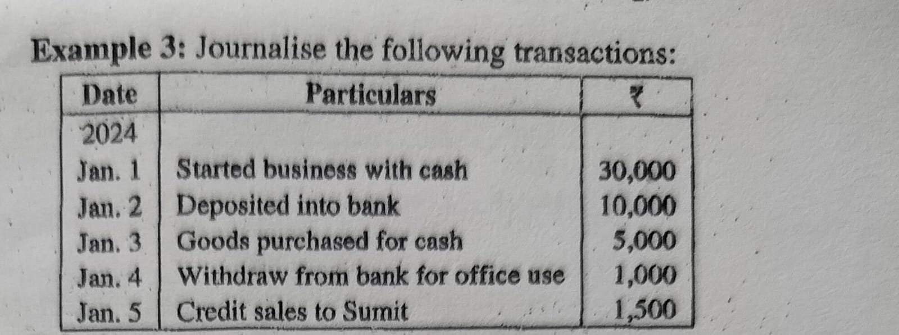

Slide 19
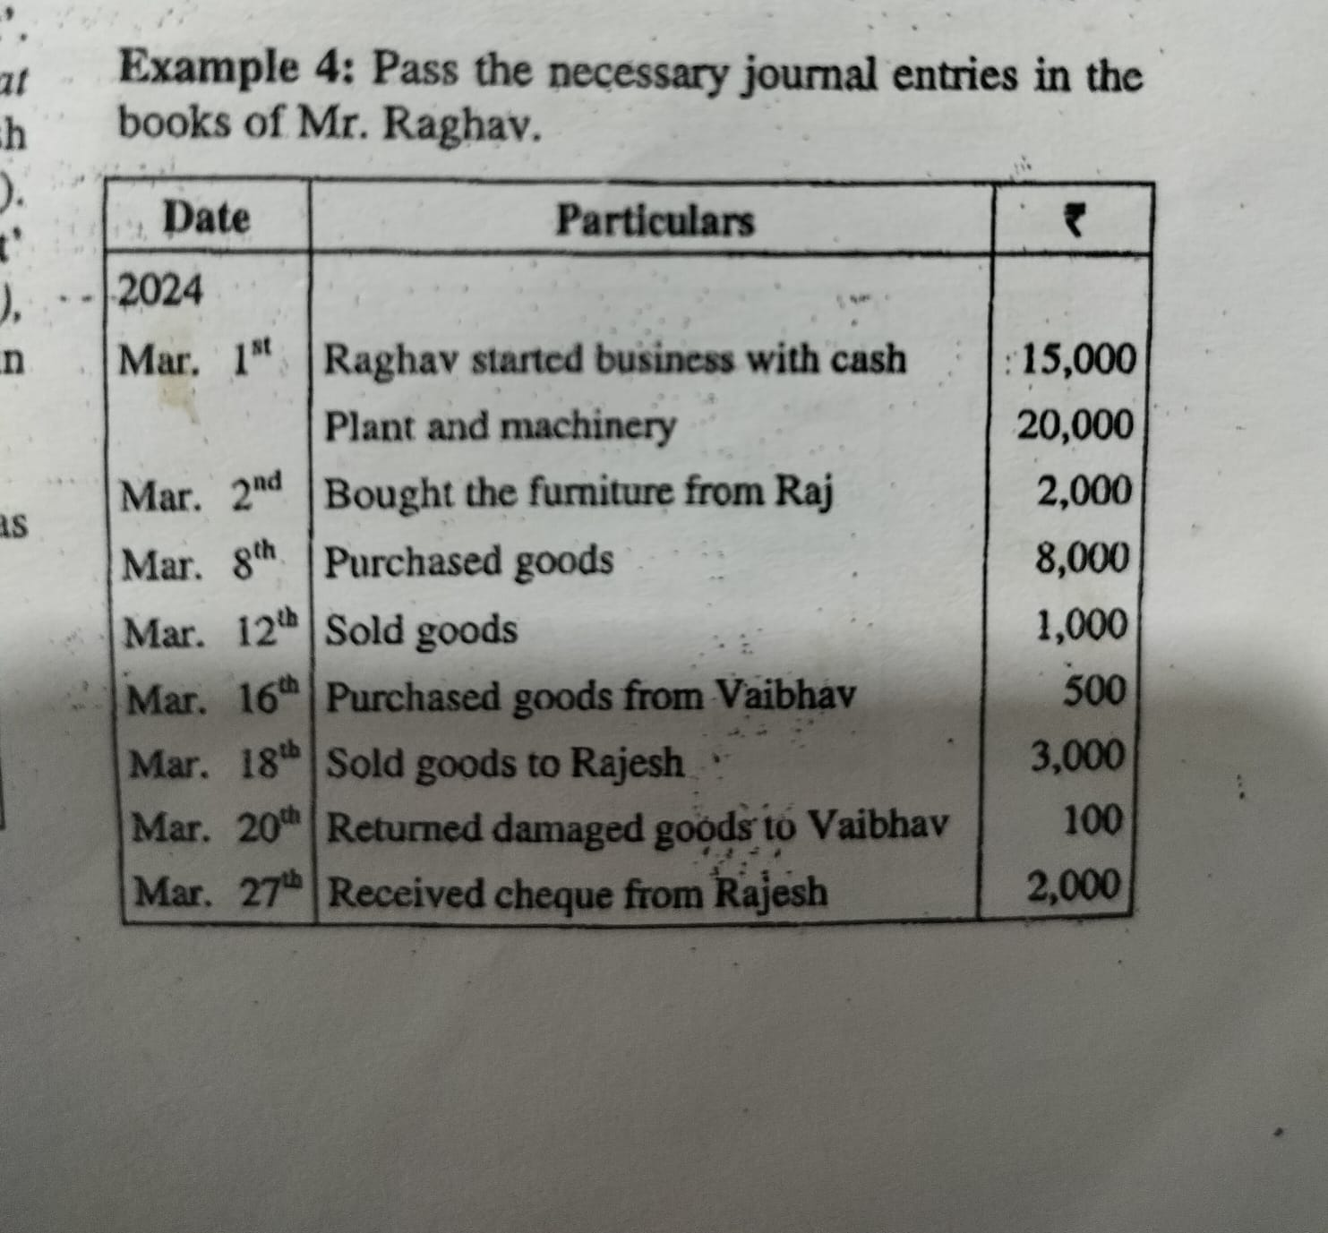

Slide 20
